Slide 1

How bUnit works

Slide 2
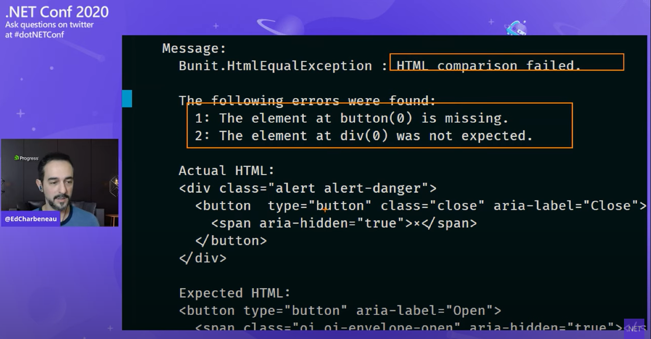
Usage basics
Blazor Stability Testing Tools for Bullet Proof Applications: https://youtu.be/WdB723tIWg0
Always learn more at: https://bunit.egilhansen.com

Slide 3
Design goals for bUnit
As easy as POCO
Sane defaults
Most things should “just work”
Fast
Easy to verify/work with HTML
Easy to pass dependencies

Slide 4
The concepts in Blazor
Implements IComponent or ComponentBase
Components
Blazor Browser Runtime (JavaScript)
Blazor C# Runtime (WASM / Server)
UI commands
Creates and maintains a DOM tree
Manages user interface
Manages components
Manages lifetime of components
JSInterop
Render tree updates
Injects services into components
Listens to user input and browser events
Runs component’s JavaScript
Builds and maintains component / render tree

Slide 5
The concepts in bUnit
Components
xUnit/NUnit/MSTest test project
Test
Blazor C# Runtime (.net)
Set up dependencies
Commands
bUnit Test Context
Manages components
Manages lifetime of components
Mock JSInterop
Request components renders
Render tree updates
Injects services into components
Access to component
Creates a DOM tree
Trigger event handlers
Separate threads
Builds and maintains component / render tree

Slide 6
Demo: new features

Slide 7
Road to v1.0.0
Stabilize the APIs
Get the Razor-based testing to stable
Finalize the documentation
Join the .NET Foundation
🙏 contributions welcome 🙏

Slide 8
Thanks, questions, goodbye 🙏 ❔ 👋
Learn more about bUnit at: bunit.egilhansen.com
GitHub repository: https://github.com/egil/bunit
Join the gitter chat at: gitter.im/egil/bunit
Follow me on Twitter: @egilhansen

